Slide 1
Laser Projector
By Fazakas Szabolcs
Advisor: Mircea Dabacan
October 6, 2006

Slide 2



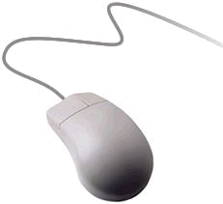
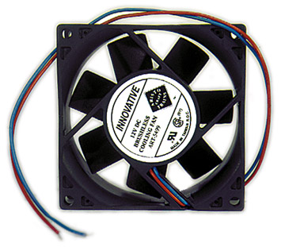

Introduction
Requires
  Nexys System Board
  Digital Input Peripheral Module
  Open Collector Peripheral Module
  Computer mouse
  80x80x25 12v cooling fan
  Small pocket laser

Slide 3
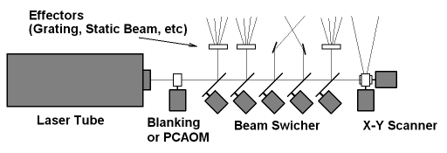
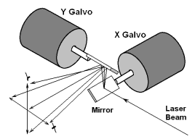
Background

Slide 4
Background
8 rotating mirror. The X coordinate is drawn using the rotating mirror:
Each mirror has a different angle to control the Y coordinate:
So with 8 mirrors you can draw 8 different lines.
To draw more lines we can use more mirrors and/or we can use more lasers.

Slide 5
Assembling
Nexys
J1
FAN
DIN1
GND
GND
VU
SENSOR
--
LED
mouse
+
OC1
J4
+
LASER
VU
--

Slide 6
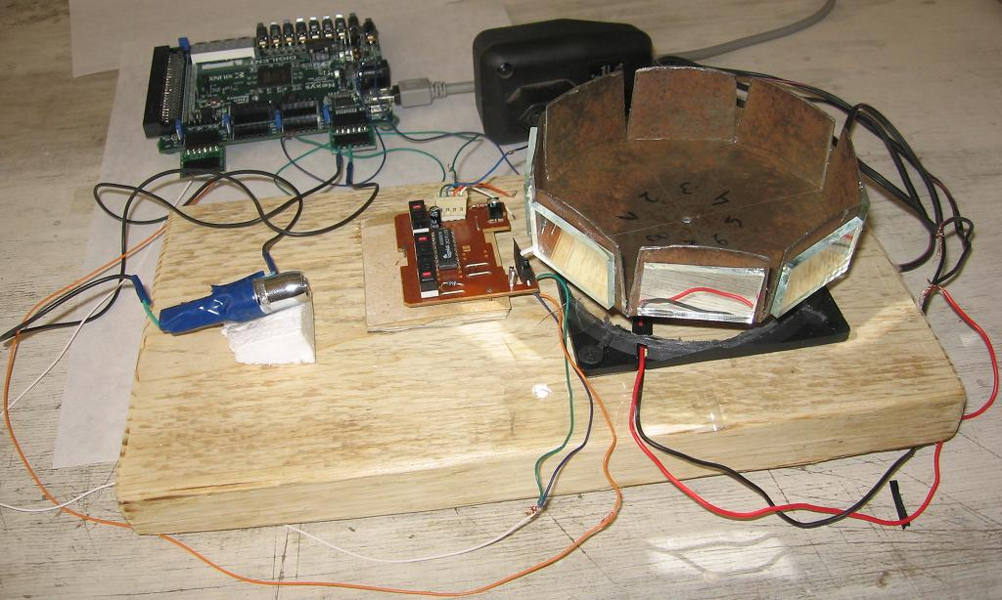
Laser Projector

Slide 7
Syncronizing
time1 – numbers of clock while the fan makes one rotation
time0 = time1 / 8
time2 – will count from time0 to 0
- when time2 = time0 / 2 we know that the laser is pointing to the middle of one mirror
- image must be projected to 20-50cm distance
- pixel ~12000Hz

Slide 8
Syncronizing
time2(21 downto 12)=time0(22 downto 13) - the laser is pointing to the mirrors middle
time2(21 downto 12)<(time0(22 downto 13)+ 17) and time2(21 downto 12)>(time0(22 downto 13)- 16)
  To change the starting position of the line we change the number with the red color.

Slide 9
Laser text projector
- 64 x 8 = 512 pixel
- 256 different character
- 2048 character long text
- 2 BlockRAMs
  - 16kx1 Single-Port RAM for the character’s form
  - 2k x 8 + 1 Parity bit Single-Port RAM for the text

Slide 10
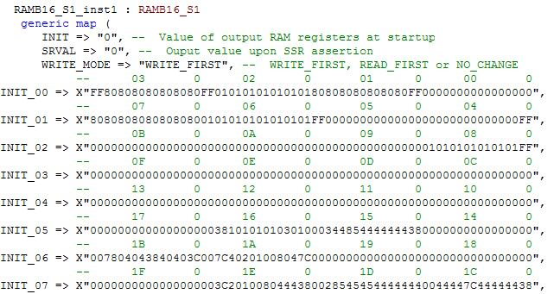
BlockRAM

Slide 11
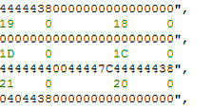
Character
"00111000" == 38
"01000100" == 44
"01000100" == 44
"01000100" == 44
"01111100" == 7C
"01000100" == 44
"01000100" == 44
"00000000" == 00
1) draw the character’s form like this and convert the bit cod to hex
0044447C44444438
2) write down the hex code beginning with the bottom number
3) write the cod in the BlockRAM, ex: the ‘A’ character’s form I keep at the “1C” address

Slide 12
Laser video projector
- 32 x 8 = 256 pixel
- 256 images
- 32 seconds
- 4 BlockRAMs (16kx1 Single-Port RAM)

Slide 13
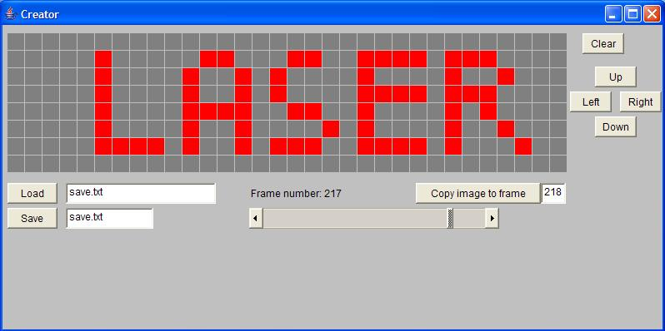
Software

